Slide 1
MRI BASIC PHYSICS
2014 Leadership Meeting

Slide 2
Objectives:
Become familiar with the basic physic concepts for MRI
Understand how physics interact with producing and image
To be able to link the basic MR physics to the MRI hardware

Slide 3
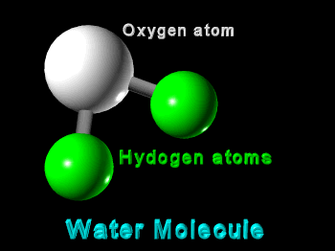
Back to basics… everything starts with the Atom
The human body is composed of water, fat and protein molecules
These molecules are made up of atoms
Atoms that have same chemical behavior are grouped as elements

Slide 4
Remember your school physics?
Atoms are formed by:
Neutrons: no electrical charge
Protons: positive charge
Protons and neutrons make up the nucleus
Electrons: negative electrical charge in orbit around the nucleus
A hydrogen atom has just one proton and one electron

Slide 5
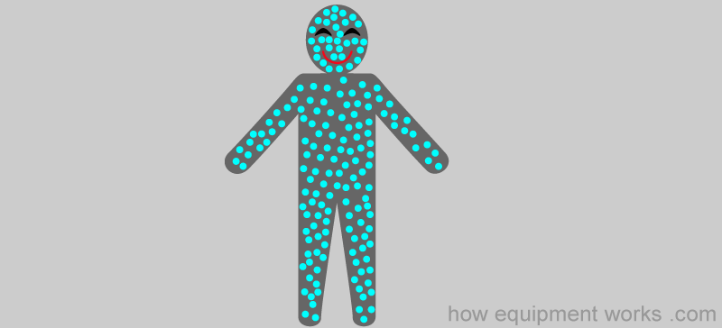
MRI Signal
MRI signal is produced by using the signal coming from the hydrogen atoms in our body
How much hydrogen do we have in our body?

Slide 6
WATER IN THE HUMAN BODY (H₂O)
By weight, the average human adult male is approximately 60% water.^{[1][2]} There can be considerable variation in body water percentage based on a number of factors like age, health, weight, and sex. In a large study of adults of all ages and both sexes, the adult human body averaged ~65% water. However, this varied substantially by age, sex, and adiposity (amount of fat in body composition). The figure for water fraction by weight in this sample was found to be 48 ±6% for females and 58 ±8% water for males.^{[3]} The body water constitutes as much as 73% of the body weight of a newborn infant, whereas some obese people are as little as 45% water by weight.^{[2]} These figures statistical averages will vary with factors such as type of population, age of people sampled, number of people sampled, and methodology. So there is not, and cannot be, a figure that is exactly the same for all people, for this or any other physiological measure.
https://en.wikipedia.org/wiki/Body_water

Slide 7
FAT IN THE HUMAN BODY
Description | Women | Men
Essential fat | 10–13% | 2–5%
Athletes | 14–20% | 6–13%
Fitness | 21–24% | 14–17%
Average | 25–31% | 18–24%
Obese | 32%+ | 25%+
https://en.wikipedia.org/wiki/Body_fat_percentage

Slide 8
Why do we use the hydrogen?
Some atom nuclei are electrically charged, hydrogen is one of them
They have a fundamental physical property call spin angular momentum or just spin
Because of their abundance and high sensitivity to the technique

Slide 9
Magnetic momentum
This electrical charge movement produces a microscopic magnetic field referred to as magnetic moment

Slide 10
Spin Quantum Number (I)
It is the quantum mechanical descriptor of the nuclei spin
Nuclei with:
Even number of protons and even number of neutrons: I = 0
Odd number of protons or odd number of neutrons: ‘half integral’ I = ½ or 3/2 or 5/2 …
Odd number of protons and odd number of neutrons: I = 1 or 2 or 3…

Slide 11


Gyromagnetic ratio
The magnitude of the nuclear dipole magnetic moment (how strong it is), it is determined by the spin quantum momentum of that nucleus and the gyromagnetic ratio of that same nucleus.
h=Plank’s constant

Slide 12
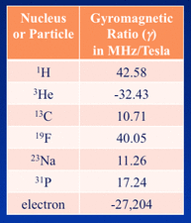
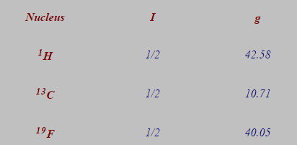
Don’t get that?
All that means it is that the strength of that dipole field is fixed and the same for all nucleus of that type.
It’s units are measured in MHz/T

Slide 13
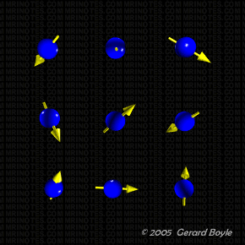
Random Spin
Outside the magnetic field, the nuclei are spinning randomly in all different direction.

Slide 14
Precession
When the body is introduced in the magnetic field, two things happen to the hydrogen nuclear magnetic dipole:
They get aligned in an angle to the direction of the magnetic field B₀
They precess around the direction of the magnetic field.
The rate of precession is measured in Hz and called the Larmor frequency

Slide 15
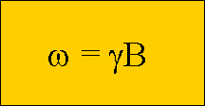
Larmor frequency
Depends on:
The strength of the external magnetic field B
The gyromagnetic ratio of the nuclei
Therefore:
ω = 42.58MHz/T x 1.5T = 63.87MHz
0.2T = 8.52MHz 0.35T = 14.90MHz
0.5T = 21.29MHz 0.7T = 29.81MHz
1.0T = 42.58MHz 3.0T = 127.74MHz

Slide 16
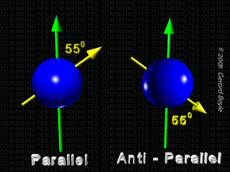
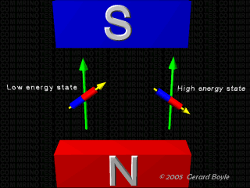
Spin state in the magnetic field
The hydrogen protons in the magnetic field can take one of two states:
- Parallel to the magnetic field or low energy state or spin-up
- Anti-parallel to the magnetic field or high energy state or spin-down

Slide 17
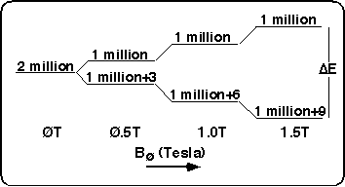
Spin Excess
When the body enters the magnetic field, for every million protons that spin up there are a million that spin down. In a 1.5T only an excess of 9 more protons will be low energy.
Protons in opposing directions cancel each other out.
How do we have enough protons to create an image?
A Quantum Physics Page!
At 1.5 Tesla, for every 2 million protons, there are 9 more protons aligned with the field than there are aligned against the field.

Slide 18
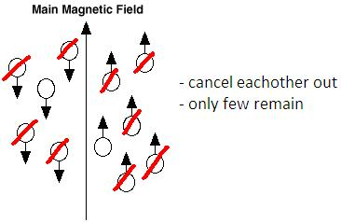

Spin Excess
How many excess protons are there in a single voxel at 1.5T?
Assume a voxel is 2 x 2 x 5 mm = .02 ml
Avogadro's Number says that there are 6.02x10²³ molecules per mole
.1 mole of water weighs 18 grams (O¹⁶ + 2H¹) has 2 moles of hydrogen and fills 18 ml, so.....
1 voxel of water has 2 x 6.02 x10²³ x 0.02 / 18 = 1.338 x 10²¹ total protons.
The total number of excess protons =
Or.... 6 million billion!!!

Slide 19
Components of dipole moment
Remember your math class? A vector has an X component and Y component.
A dipole has a longitudinal component in the direction of the magnetic field and a component 90º to this one transverse component.
The transverse component spins at the Larmor frequency in the transverse plane.
The longitudinal component can be a parallel or anti-parallel magnitude.
Y
X

Slide 20
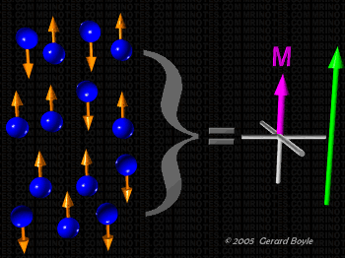
Bulk Magnetization
Since we are unable to look at these dipoles together all we can do is look at millions of them together. The resultant vector sum is known as bulk magnetization M.
Longitudinal Component
The up and down component mostly cancel each other out and only a few (remember? 6 million billion) make up the bulk magnetization in the main field direction usually called M₀
Transverse Component
The transverse components all rotate out of phase. Because each dipole has its corresponding dipole rotating at 180 degrees out of phase, there is no transverse component.

Slide 21
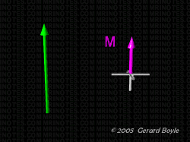
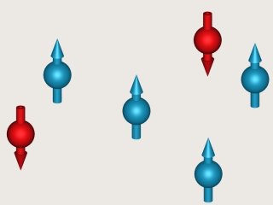
Bulk Magnetization
All we have are the “few” excess of up protons as a small overall longitudinal bulk magnetization vector M pointing in the direction of the main magnetic field.

Slide 22
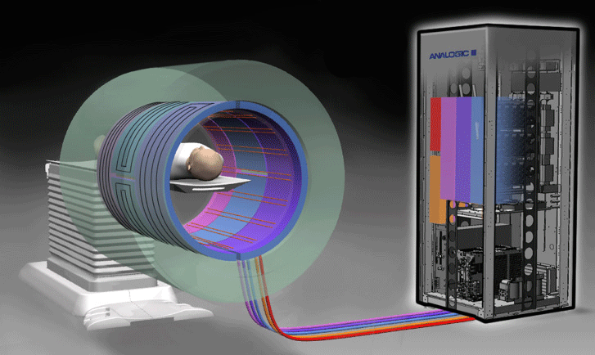
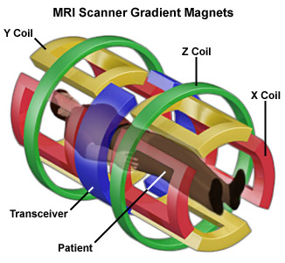
Gradient coil
The gradient coil is made of windings of wire or thin conductive sheets that create a secondary magnetic field (gradient field).
The gradient field changes the magnetic field in a predictable and controlled pattern, changing the resonance frequency of the dipoles according to location

Slide 23
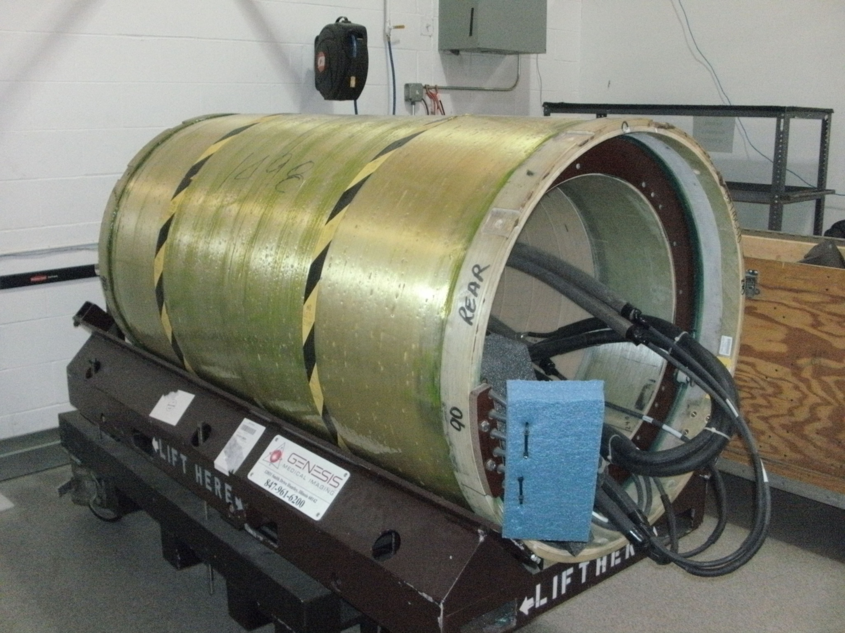
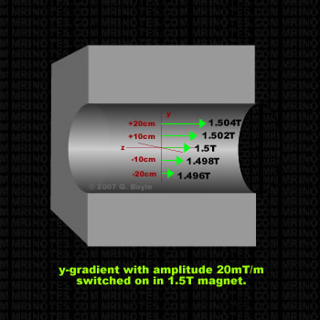
Gradient coil
The function of the gradient coil is therefore spatial encoding.
Gradients are used for:
Slice selection: gradients are used to select which slice of the patients' body is being scanned
Image localization (phase and frequency encoding): technique used to determine the spatial location of the signal detected by the receive coil
Gradient echo imaging: gradients generate echos used in image formation

Slide 24
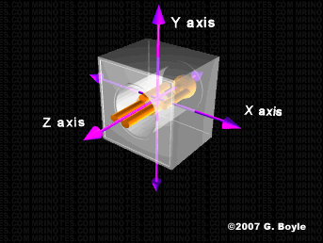
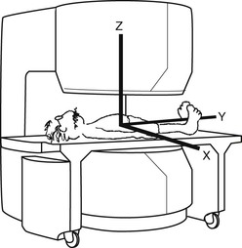
Gradient fields
Coordinate system:
In MRI Z-axis always follow the B₀ or main magnetic field and the other two axis will be x and y

Slide 25
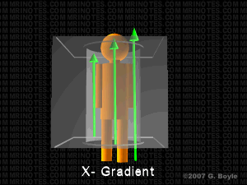
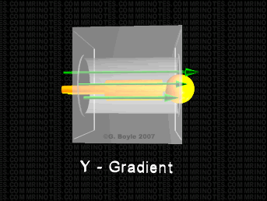
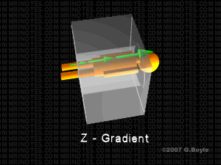
Gradient fields
X, Y and Z gradients are turn on and off quickly during scanning to produce slight variations in the direction of the gradient.

Slide 26
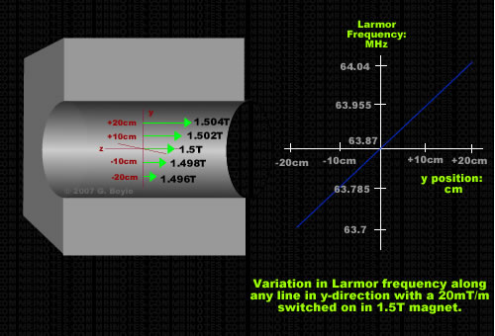
Gradient fields
At isocenter, the magnetic field and Larmor frequency remain unchanged it is always, i.e. 1.5T and f=63.87MHz
Example:
20mT/m = 0.02T for a 1.5T magnet.
Then for +10cm from iso:
f= 42.58 (1.5 + 0.1(0.02) = 42.58 (1.502) = 63.955MHZ
And for -10cm from iso:
f= 42.58 (1.5 - 0.1(0.02) = 42.58 (1.498) = 63.785MHZ

Slide 27
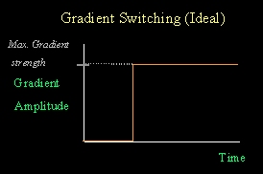
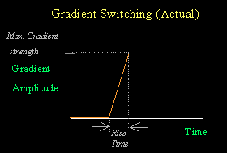
Gradient fields
The maximum gradient field strength is the strongest gradient strength a system can reach
The slew rate is the maximum rate of change a system can support

Slide 28
Radio Frequency Transmitter (RF Amplifier)
An RF field is applied repeatedly in the form of very brief pulses. The physical effect of applying an RF pulse to the dipole is equivalent to applying a magnetic field in the transverse direction.
The dipoles then start spinning for a brief moment in the transverse direction before they go back to the normal state spinning around the B₀ field.

Slide 29
Radio Frequency Transmitter (RF Amplifier)

Slide 30
Flip Angle
By applying an appropriate RF pulse, we can achieve any flip angle. The most typical flip angles are 90 and 180 degrees.

Slide 31
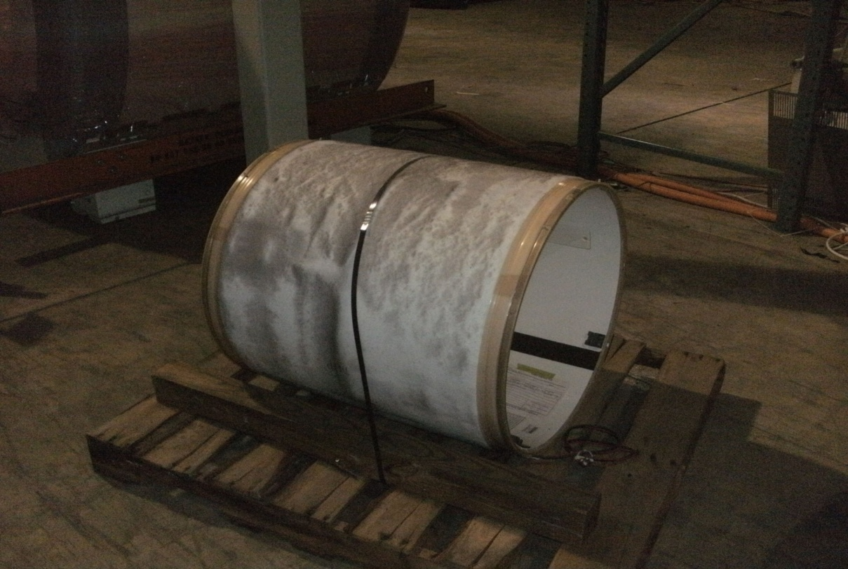
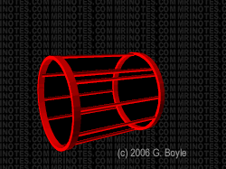
Transmit Coils
Some coils are transmit/receive or transceivers and some others are only receive coils.
Coils in charge of transmitting the RF signal, i.e. body coil, standard head coil, knee t/r coil; transmit the RF pulse generated by the RF amplifier and they are able to switch to receive mode or use a different coil to receive.
The most typical and efficient design for transmit/receive coils is the quadrature or birdcage design where we have two coils at 90 and 180 degrees (I and Q).
Dimensions: 28.5”L X 25”W X 25”H
Weight: 40LBS

Slide 32
Receive coils
We cannot measure the longitudinal bulk magnetization
We are able though of detecting the bulk magnetization once we apply an RF pulse and we make it rotate in the transverse plane and we use a coil to detect the signal
The most basic form of a coils is just a copper loop.
The receiver coil detects the transverse component and converts it to a time varying voltage that would be digitized and process by the system.

Slide 33
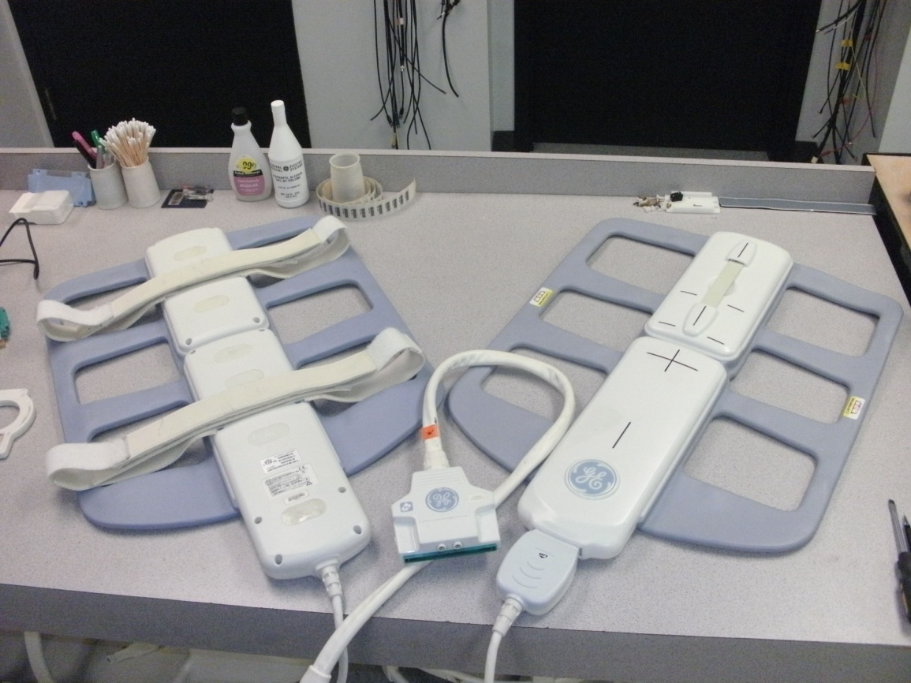
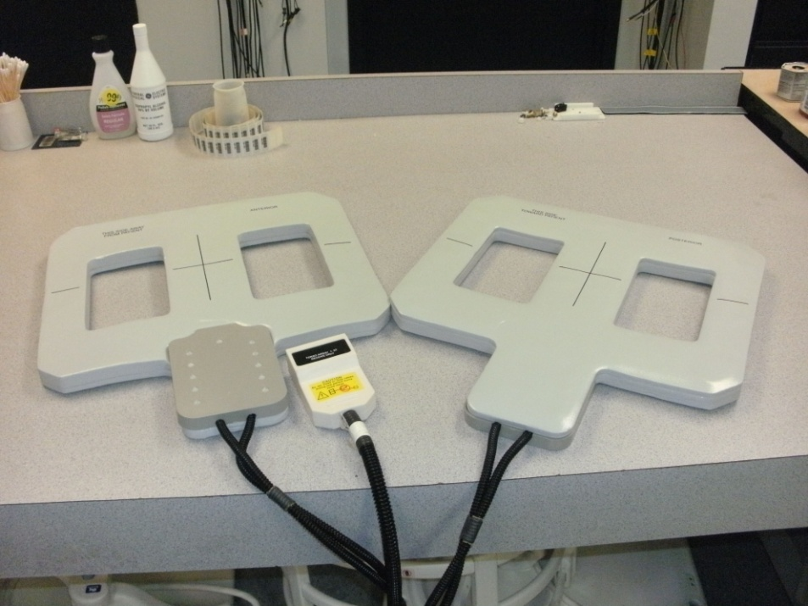
Surface coils
As the name indicates the surface coil are dedicated coils that are positioned close to the anatomy to be examined
As the coil is smaller and in really close proximity to the area of study, the biggest advantage is a much higher SNR compared to using the body coil as a receive coil.

Slide 34
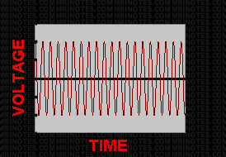
Receive coils
The current induced in the coil is proportional to the rate of change of the magnetic flux linking the coil
Every rotation in the transverse plane induces a cycle to peak through the coil
The frequency is the same as the spinning frequency of the transverse component.
If the signal would remain constant it would create a sinusoidal wave. In reality the signal dies off quickly and the detected signal will be a decaying sinusoidal wave.

Slide 35
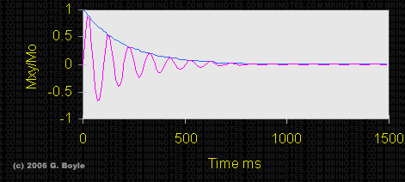
FID
Remember the signal received by the coil is a decaying sinusoid signal.
It is decaying because the amplitude of the transverse component magnetization decays.
It is sinusoidal because of the spinning in the transverse plane.
This is called Free Induction Decay or FID.
- Pink line shows the FID
- Blue line is the exponential line determined by the tissue T2.

Slide 36
T1
As the RF pulse is turned off, the protons start to lose the energy and they begin to go back to their original low energy state spinning around the magnetic main field. The time that it takes for this to happen is what it is referred to as T1 relaxation or T1 recovery.

Slide 37
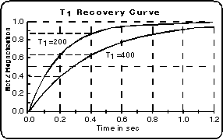
T1
NOTE: T1 values are longer in general in higher magnetic fields.
T1 times are different for different tissues.
At time t=T1 after the excitation pulse, 63.2% of the magnetization has gone back to alignment with B₀.
5 T1 times are required to go back to equilibrium.

Slide 38
T2
The only reason we get a signal is because the RF pulse forces the protons to spin in phase. As soon as the RF signal disappears and the protons start to spin out of phase (spin dephasing), the transverse component starts to fall off. The time that it takes for the protons to be in the normal main magnetic field state rotating out of phase is what we call T2 relaxation.

Slide 39
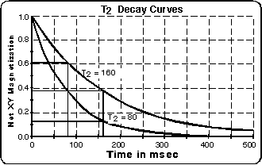
T2
T2 times are different for different tissues.
At time t=T2 after the excitation pulse, 36.8% of the protons are out of phase.
5 T2 times are required to go back to equilibrium or relaxation be completed.
NOTE: T2 values are unrelated to magnetic field strength.

Slide 40
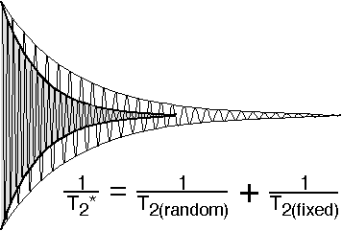
T2*
In a perfect magnet, T2 would always happens the same. In the real world, magnets have imperfections and inhomogeneities. Patients also might have metal implants. The sum of all these random effects is called T2* (T2 star) .
T2* is in reality, faster than T2.

Slide 41
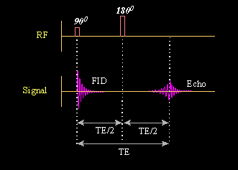
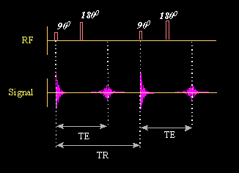
Spin Echo (SE)
The simplest form of a scan is a spin echo.
It consists of a 90º pulse followed by a 180º pulse. Several hundreds of them one right after the other.
The delay between the 90º pulse and the time the echo occurs is called TE or echo time.
The time delay between the 90º and 180º pulse is TE/2.
The time between successive 90º pulses is called TR or repetition time.

Slide 42
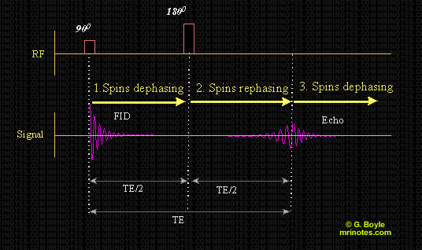
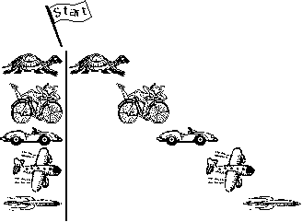

What’s an echo then?
We don’t really work with the FID.
To be able to create more signal we use the 180-degree pulse to rephase the protons as these are dephasing.
The 180-degree pulse is also called refocusing pulse.
This rephasing and dephasing creates the usable signal called an echo, a mirror FID.

Slide 43
Spatial Localization
We know then what happens with the signal but, how do we get the information about where that image is from?
We use the gradients to add the spatial localization to the image.

Slide 44
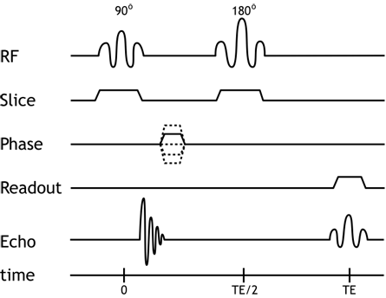
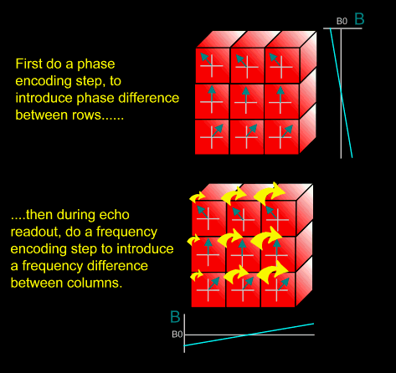
Spatial Localization
The slice-select gradient determines which protons are going to be excited, therefore, it needs to be turned on during any of the excitation pulses, i.e. 90 and 180-degree pulses.
The phase-encoding gradient is turned on to add a phase shift. This happens while we are waiting for the echo. The protons will keep that phase shift.
At the time of echo, we then turn on the frequency-encoding or readout gradient, since we need the precession frequencies to be altered to read them.

Slide 45
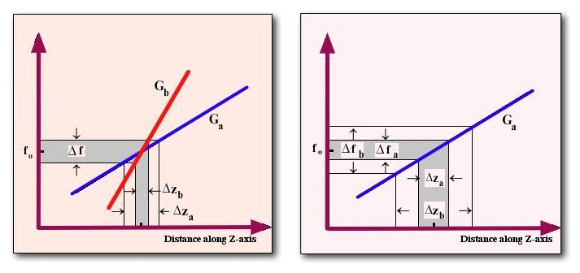
Spatial Localization
Slice-select:
We can change the slice thickness by either changing the gradient field or changing the transmitting frequency bandwidth (BW).
Therefore, lower volumes and smaller slices will stress the gradient being used as slice.

Slide 46
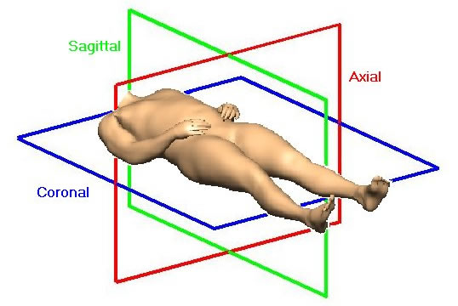
Spatial Localization
The physical gradients assume different jobs depending on the scan plane that is being selected.

Slide 47
Spatial Localization
BODY | SLICE | Phase | Direction | Frequency | Direction
AXIAL | Z | Y X | AP RL | X Y | RL AP
SAGITAL | X | Y Z | AP SI | Z Y | SI AP
CORONAL | Y | X Z | RL SI | Z X | SI RL
HEAD | SLICE | Phase | Direction | Frequency | Direction
AXIAL | Z | X Y | RL AP | Y X | AP RL
SAGITAL | X | Y Z | AP SI | Z Y | SI AP
CORONAL | Y | X Z | RL SI | Z X | SI RL

Slide 48
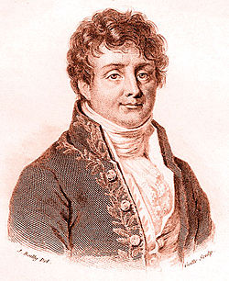
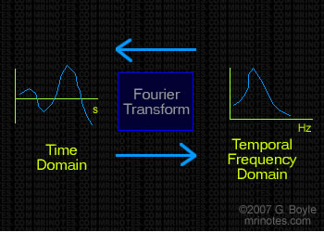
Fourier Transform
Thanks to the French mathematician Joseph Fourier, we have algorithms that convert any waveform from the time domain into the frequency domain.
When the Fourier Transform (FT) operates in the one dimensional domain it is a 1-D FT.

Slide 49
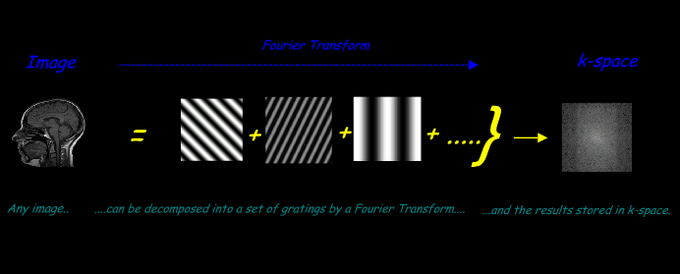
Fourier Transform
In a 2-D Fourier Transform, raw data, the collection of phase and frequency information, can be turned into 2D sine wave gratings that each have a particular amplitude and spatial frequency to form the images. With Fourier Transform we can turn raw data into and image or use Reverse Fourier Transform to decompose the image into the raw data. The frequency domain it is known as the k-space.

Slide 50
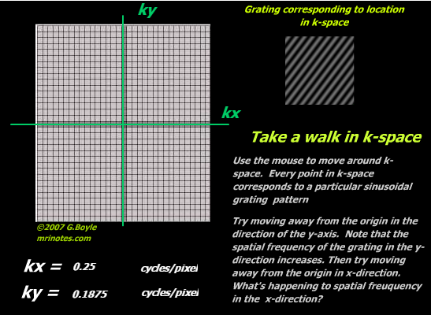
k-space
It is a 2D plane with axes kx and ky.
Any point in the k-space corresponds to a particular 2D sinusoidal grating.
Note: Visit http://www.mrinotes.com/ Chapter 3.4:k-space for image interaction

Slide 51
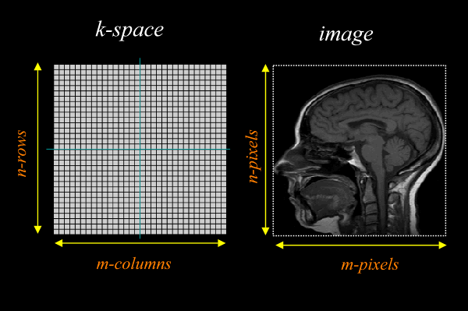
k-space
Depending on the matrix selected, the k space will consist of n-rows by m-columns.
The number of points we need to get the k-space filled is known as the matrix size and usually represented by the letter N. We usually describe the matrix by its selection, i.e 256x256, 192x256, etc.
The x-axis of the k-space is the frequency-encoding information.
The y-axis of the k-space represents the phase-encoding information
The gradients control the position in the k-space
Phase-encoding information is acquired for all different frequencies until we have collected all the points of information for the desired matrix selected .

Slide 52
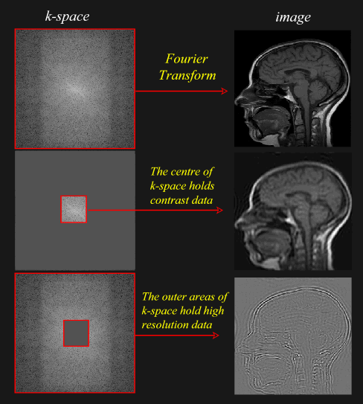
k-space
The k-space has no one to one correlation with the real image. Each point contains information from every part of the image.

Slide 53
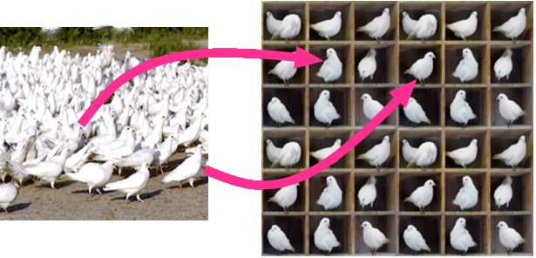
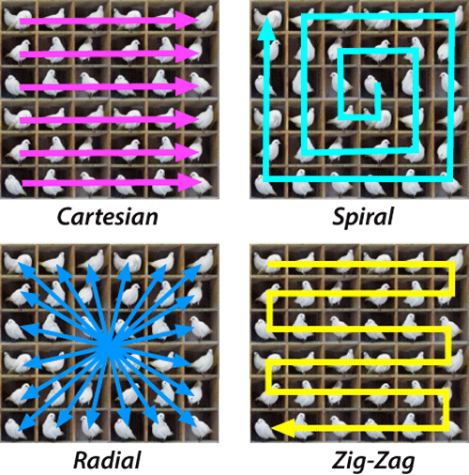
Filling the k-space
Depending on the sequence and options used, there are many ways of filling the information in the k-space

Slide 54

Image Contrast

Slide 55

Image Contrast
Three factors differentiate the types of tissues from an MR imaging perspective: T1 values, T2 values and Proton Density (PD) (number of active protons per unit volume of the tissue).

Slide 56
Image Contrast
T1 weighted images: emphasizes the contrast based on the different T1 values between tissues
T2 weighted images: emphasizes the contrast based on the different T2 values between tissues
PD weighted images: the contrast is determined by the difference in proton density values between tissues
We control this by modifying the values of TR and TE.

Slide 57


Image Contrast TE: reading the transverse component
Short TE:
A short TE time does not give time for T2 relaxation, therefore, short TE times diminishes the contrast effect based on the tissue T2.
Long TE:
A long TE time allows for T2 relaxation, therefore, long TE times emphasizes the contrast effect based on the tissue T2. Maximum contrast is achieved when TE is about the average of the two T2 values of the tissue.

Slide 58


Image Contrast TR: reading the longitudinal magnetization
Long TR:
A long TR time gives the protons enough time to go back to the equilibrium state precessing around the main magnetic field. Long TR times diminish the effect of the contrast based in the difference in the T1 value between tissues
Short TR:
A short TR emphasizes the T1 differences.

Slide 59
Image Contrast PD: nobody’s land
In PD weighted images, the differences in contrast should come from solely the difference in PD between tissues. We need to, therefore, eliminate the effects of T1 and T2.
To do this we will have to use longer TR times (minimize T1 effect) and shorter TE times (minimize T2 effects)

Slide 60

Image Contrast

Slide 61
Videos
https://www.youtube.com/watch?v=Ok9ILIYzmaY
https://www.youtube.com/watch?v=1CGzk-nV06g
https://www.youtube.com/watch?v=pGcZvSG805Y

Slide 62
Videos
https://www.youtube.com/watch?v=p3WnFYBnghU
https://www.youtube.com/watch?v=XCrpMwz6Z1g
https://www.youtube.com/watch?v=MiL0wCZr0Mw

Slide 63
Videos
https://www.youtube.com/watch?v=lKp67IqQjH4&list=PL40F1EE0DF59D777A&index=1
https://www.youtube.com/watch?v=is8TscwFOvM&index=2&list=PL40F1EE0DF59D777A
https://www.youtube.com/watch?v=_7oZMA0OuK4&list=PL40F1EE0DF59D777A&index=3
https://www.youtube.com/watch?v=GDElT6Tz7_Q&list=PL40F1EE0DF59D777A&index=4
https://www.youtube.com/watch?v=ZHtfnNAz-UM&list=PL40F1EE0DF59D777A&index=5
https://www.youtube.com/watch?v=LvyADhrgc_s&list=PL40F1EE0DF59D777A&index=6
https://www.youtube.com/watch?v=p3WnFYBnghU

Slide 64
Book
http://www.mri-physics.net/textuk.html

Slide 65
References:
http://medicalphysicsweb.org/cws/article/research/60077
http://www.mrinotes.com/
http://mri-q.com/superconductive-design.html
http://mri-q.com/gradient-coils.html
https://en.wikipedia.org/wiki/Body_water
https://en.wikipedia.org/wiki/Body_fat_percentage
http://www.howequipmentworks.com/mri_basics/
http://www.xrayphysics.com/sequences.html
http://www.xrayphysics.com/spatial.html#k
http://www.simplyphysics.com/page2_11.html
http://www.mridoc.com/physics/
http://www.sprawls.org/mripmt/MRI01/index.html

